Slide 1

SAP BTP ABAP on Cloud / RAP Training
DAY-10
Anubhav Oberoy
www.AnubhavTrainings.com
Follow excellence with sheer passion

Slide 2


DISCLAIMER
The training content and delivery of this presentation is confidential, and cannot be recorded, or copied and distributed to any third party, without the written consent of Anubhav Trainings

Slide 3

01
Attachments
02
API HUB
03
Custom Entity
04
Steampunk
Notes:
https://pixabay.com/photos/san-francisco-transamerica-pyramid-1633203/

Slide 4
Steps
Create new attachment table according to need and design
Create a Interface Entity for the attachment table and mark our attachment field with special attachment annotation, So the RAP framework can treat it as an attachment accordingly.
Add annotations for admin fields, and user labels.
Create composition of our attachment table with travel entity like we had the composition of booking with travel entity.
Create a projection view for attachment
Relationship between Travel processor view with attachment processor view entity
Enhance the BDEF with attachment like booking
Also expose the attachment functionality with draft to processor in behavior projection for processor
Expose the entity of attachment processor in service definition
Republish the OData V4 binding
Add the metadata extension for attachment scenario and link a new facet in travel for attachment table
Testing
www.anubhavtrainings.com

Slide 5

















Slide 6

















Slide 7
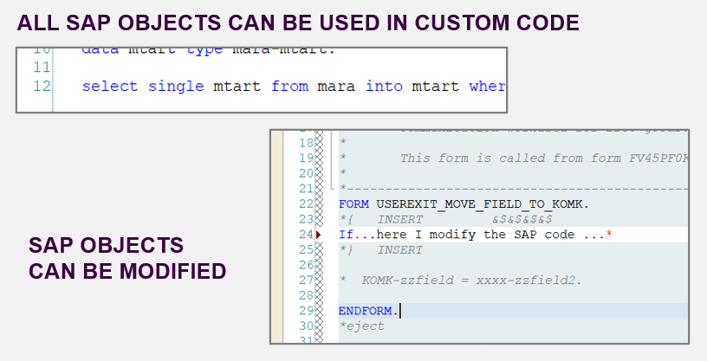
From classic ABAP extensions to ABAP Cloud development
<>
www.anubhavtrainings.com

Slide 8
What is ABAP Cloud Development Means:
Use public SAP APIs (local or remote) released by SAP to access SAP functionality and SAP data
Use public SAP extension points released by SAP to extend SAP objects. Modifications to SAP standard objects are not supported (applies to S/4HANA Cloud system)
Use of Adt (ABAP development tools) on eclipse
Use Steampunk (RAP – Restful Application Programming model) to build Fiori Applications and services. SAP technologies like Dynpro and webdynpro are not released for cloud development.
www.anubhavtrainings.com

Slide 9
What is Embedded Steampunk
If we are using SAP BTP to develop side by side extensions, full stack SAP applications in BTP (Steampunk)
If we are using In-app Developer extensibility with released objects in S/4HANA (all editions) with RAP (Embedded Steampunk)
If you using RAP and enhancing your Standard SAP Applications delivered by SAP in S/4HANA system, the recommended approach is Embedded Steampunk.
Every Customer using S/4HANA can decide whether they want to use new approach (embedded Steampunk) or classic extension approach (BADI) @ Object level
This can be done by switching a setting @ object level.
www.anubhavtrainings.com

Slide 10
Finding RAP extension objects in ADT and HUB
As a developer in our company how can we ensure or find the released SAP object (CDS views, APIs, RAP business object) so when a requirement comes to me for enhancing standard Fiori Apps or functionality in S/4HANA, I can use the embedded Steampunk for developer extensibility.
Directly using ADT – appl:sd api:extend_in_cloud_development
Refer the documentation on https://api.sap.com
Example of Sales order
SAP Standard Fiori App
I_SalesOrderTP
C_SalesOrderManage
R_SalesOrderTP
www.anubhavtrainings.com

Slide 11












Slide 12
Steps to Activate Standard App
We need to find the sales order application in SAP Fiori App reference library
We need to check its configuration
Activate the Standard Fiori App using Rapid Fiori Activation Task list and generate the role
Will activate all the odata services, and configure catalog and group with the role so that our user can access the Fiori apps.
Tcode: STC01
Tasklist: SAP_FIORI_CONTENT_ACTIVATION
Role: SAP_BR_INTERNAL_SALES_REP
Go to PFCG and assign the role ZSAP_BR_INTERNAL_SALES_REP
Assign the role to our user to access this Fiori app
Make sure that in SPRO all the pricing conditions, pricing procedure and mapping of Sales org with procedure in tcode OVKK is maintained – Functional consultant
Test Data: if you are using Anubhav training system to demo this scenario use below test data:
Order Type: ZDPL
Sales Organization: CCPL
Distribution Channel: ZG
Division: 01
Ship to Party: 610000
Material: 167
Testing – Create sales order - /n/ui2/flp
server@anubhavtrainings.com
Subscribe an S/4HANA 2023 OP system access @ 40 USD per month
www.anubhavtrainings.com

Slide 13
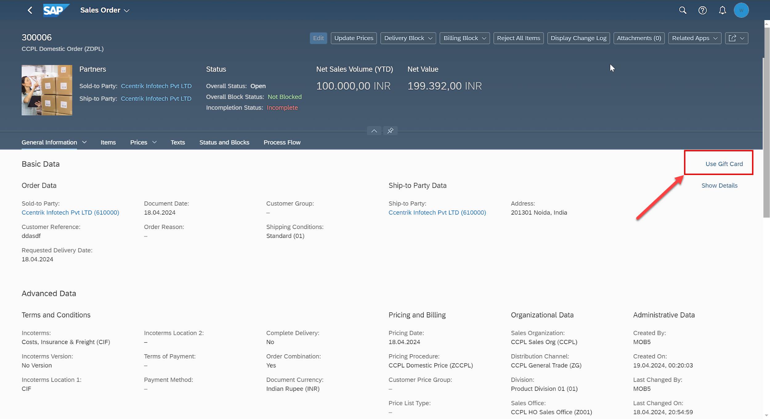
Demo Scenario
<>
www.anubhavtrainings.com

Slide 14
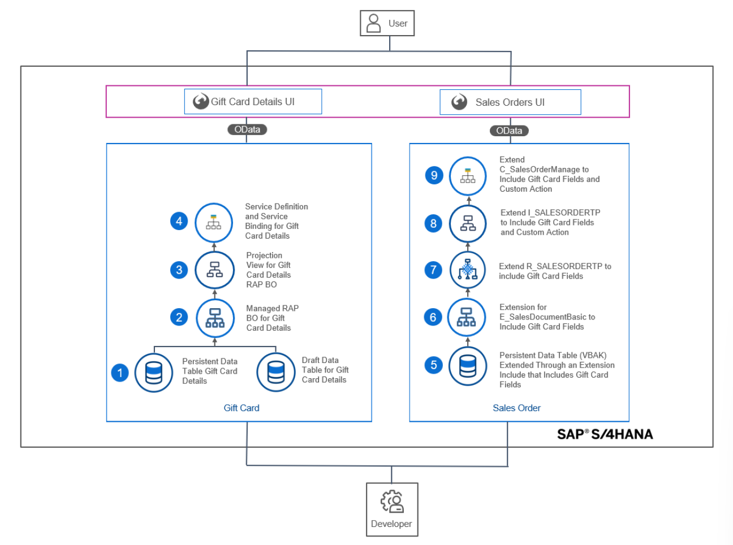
User Persona
<>
www.anubhavtrainings.com

Slide 15
Development Flow of Scenario
<>
www.anubhavtrainings.com

Slide 16
Documentation link
RAP Extensibility
https://help.sap.com/docs/abap-cloud/abap-rap/extensibility-architecture-overview?locale=en-US
Event
https://help.sap.com/docs/abap-cloud/abap-rap/business-events?locale=en-US&q=business%20event
www.anubhavtrainings.com

Slide 17
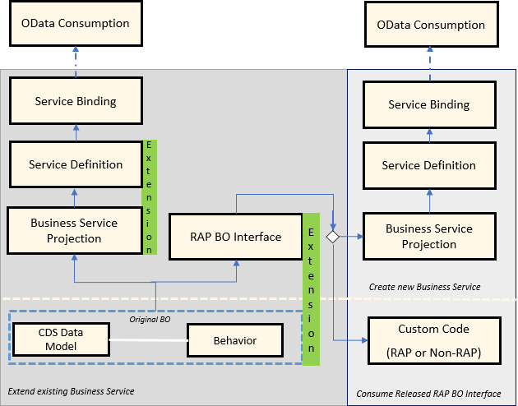
Embedded Steampunk – RAP Extensibility
www.anubhavtrainings.com

Slide 18
Abstract Entity
It is an entity which cannot be used as part of a business object directly. They are solely use for the purpose of exchange of data as a parameter. Like in ABAP we create local types and structures which are used as import/export parameters in our FM and classes.
www.anubhavtrainings.com

Slide 19
www.anubhavtrainings.com
Thank You
End of Day 10
www.anubhavtrainings.com

Slide 20


We’re committed to empower you to be
#FutureReady
through powerful training solutions.
We build the workforce of the future.
250+
Corporate Clients
30,000+
Learners Trained
25000+
Learners Placed
FREE WEBINARS
Sign up for free webinars with industry experts every fortnight!
Enroll Now!
Contact us today!
https://anubhavtrainings.com

